Slide 1
Kings County Housing Data Analysis
Joongsuk Jin
3/12/2019

Slide 2
Purpose of Modeling/Analysis
Three questions for investors?
If you are buying a house, what are the features to look at to know a market value of the house?
Where is the most desirable location (zip code) to purchase a house depending on the budge
Based on the features (preference of a house), how accurately can we predict the house? And how can we see if a house is overvalued or undervalued?

Slide 3
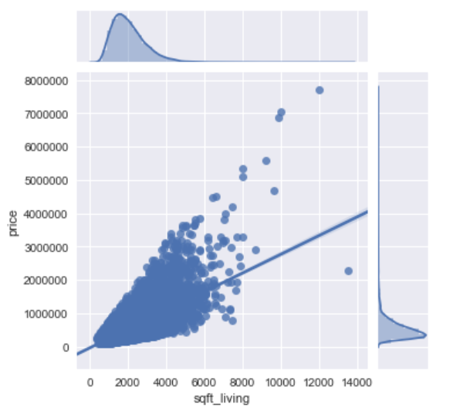
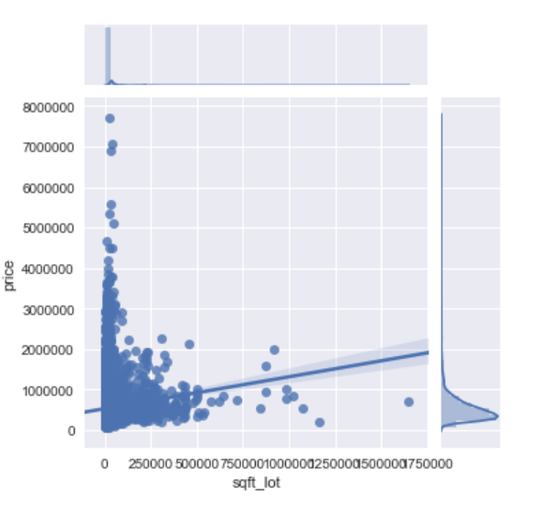
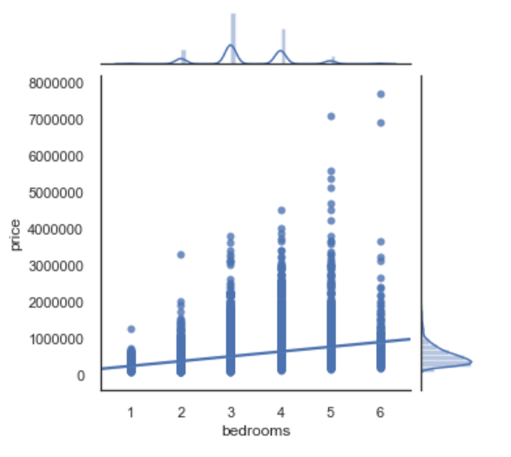
Final Selected Features
If you are buying a house, what are the features to look at to know a market value of the house?
Bedrooms
Sqft_living
Sqft_lot

Slide 4
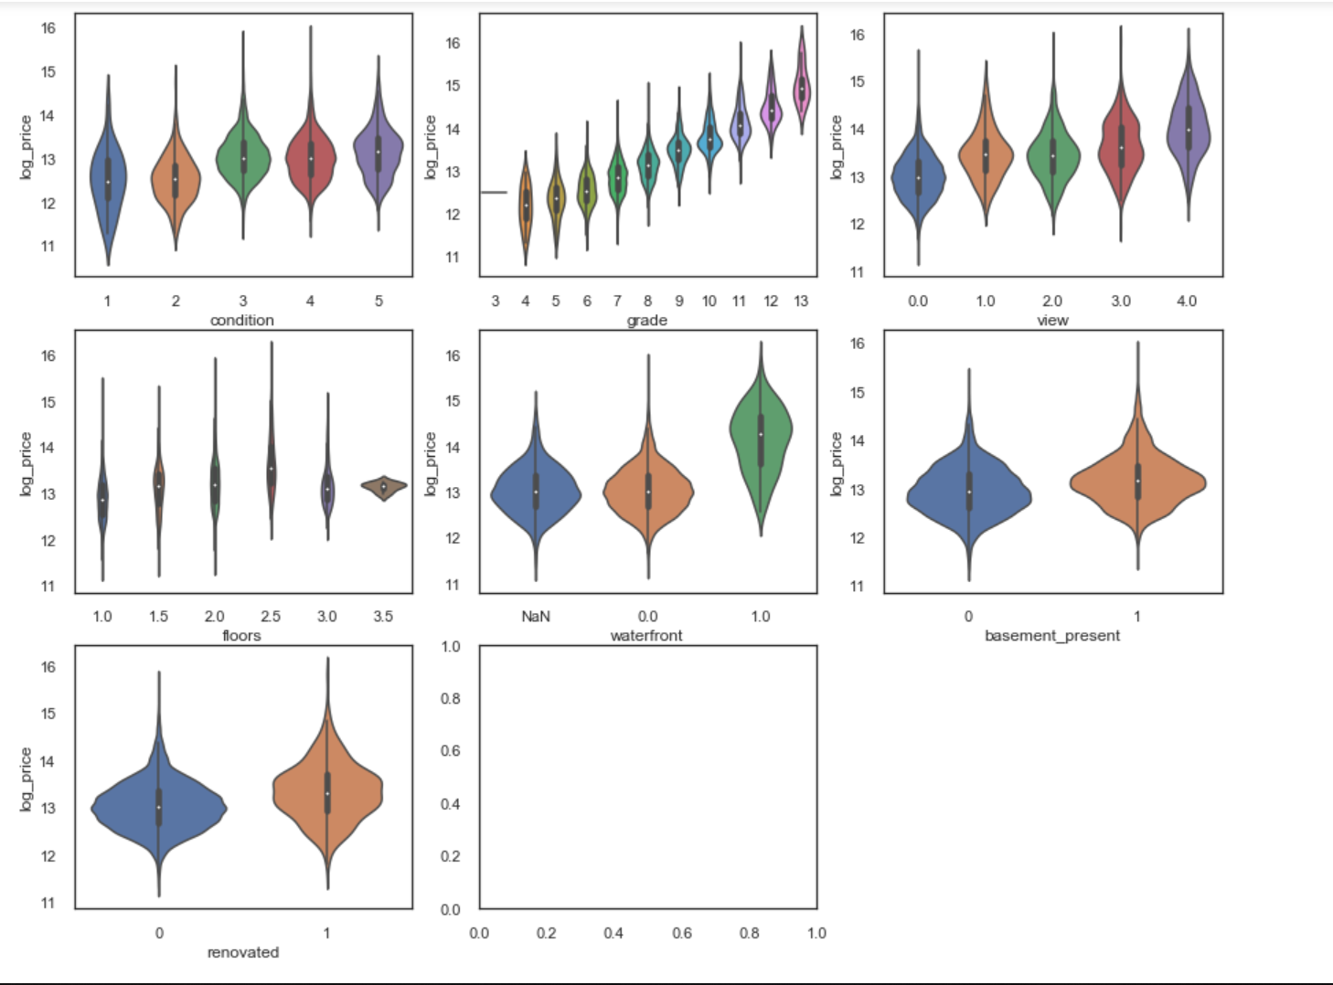
Final Selected Features
If you are buying a house, what are the features to look at to know a market value of the house?
Floors , Views, Grade

Slide 5
Final Selected Features
Where is the most desirable location (zip code) to purchase a house depending on the budge
Zipcode or location didn’t have strong enough relationship towards price prediction model
The research indicates that focusing on the other features of house will drive more accureate prediction of overall value of the house
If we have the over value of a house, we can compare to the market value and find out if the property is over valued or under valued (opportunity)

